Slide 1
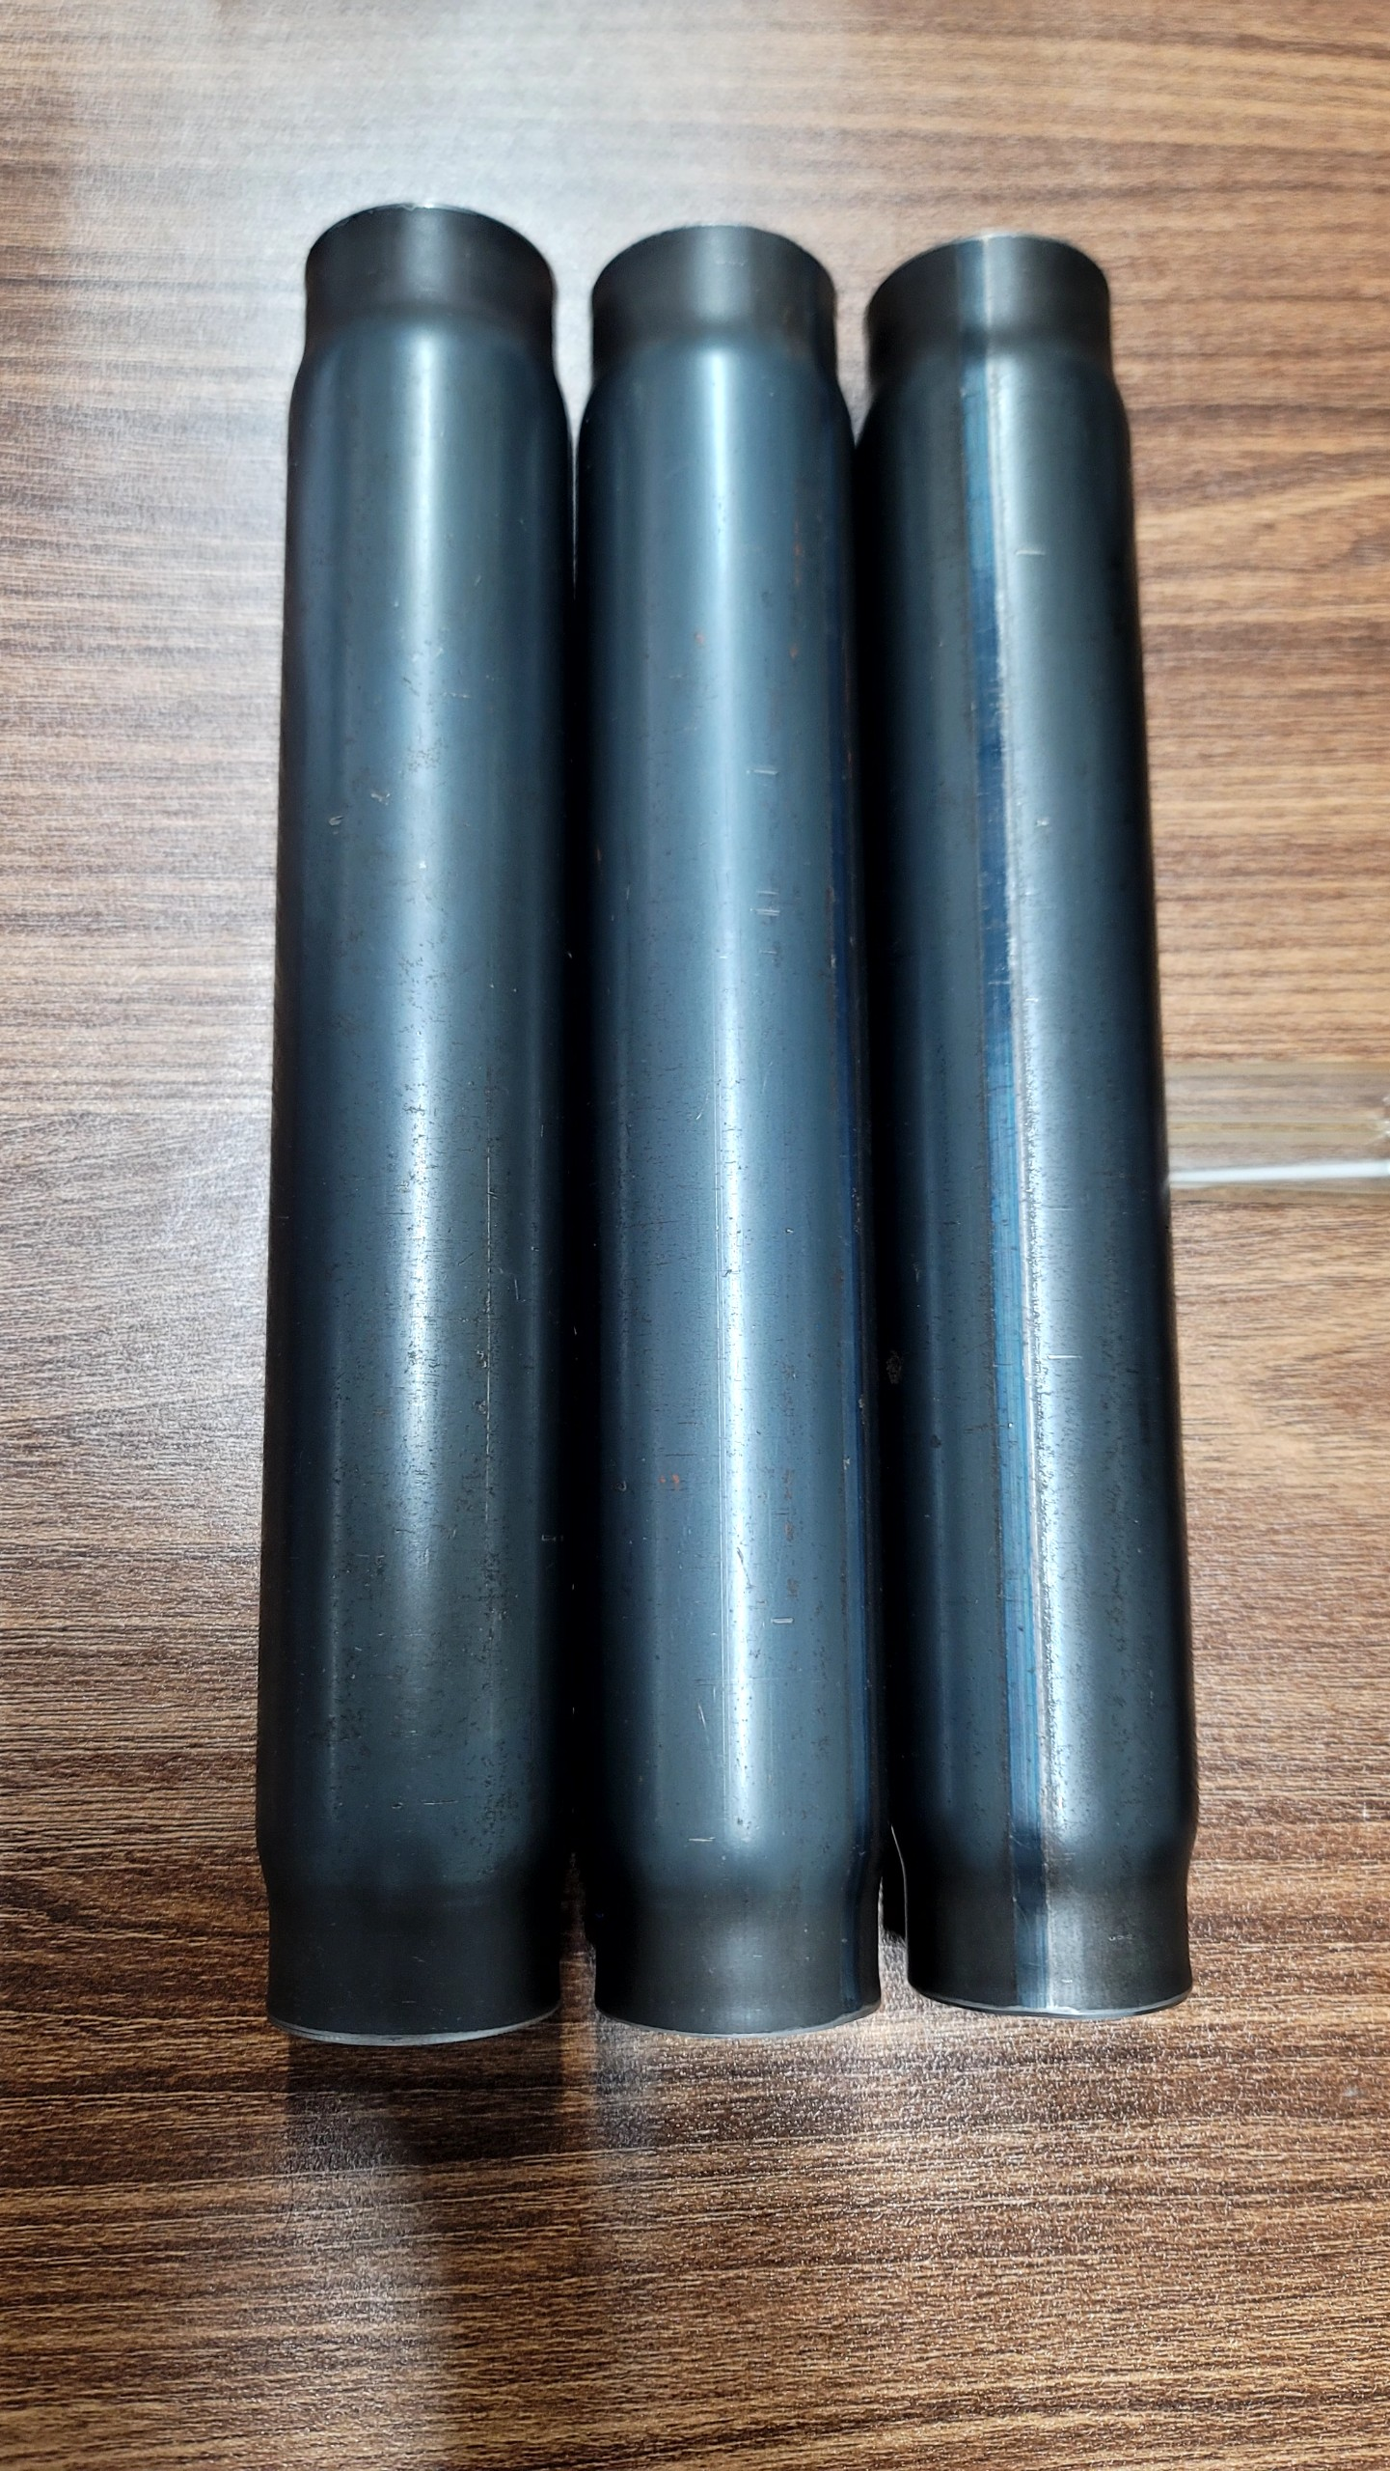
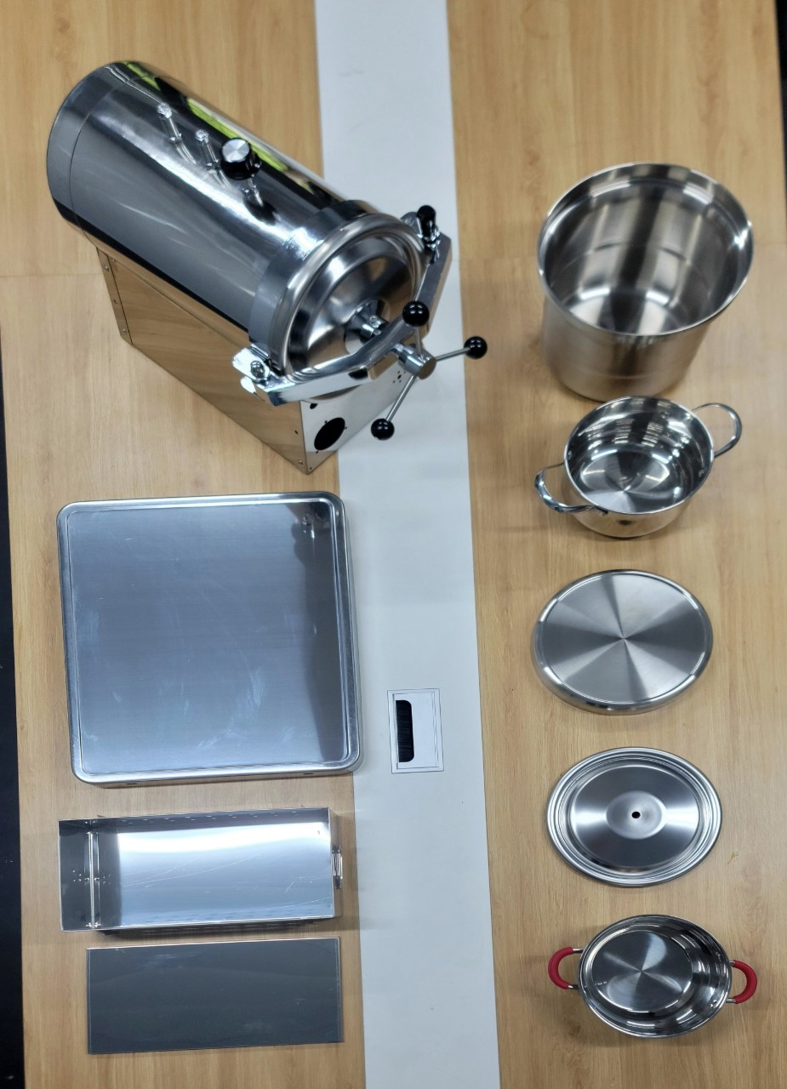
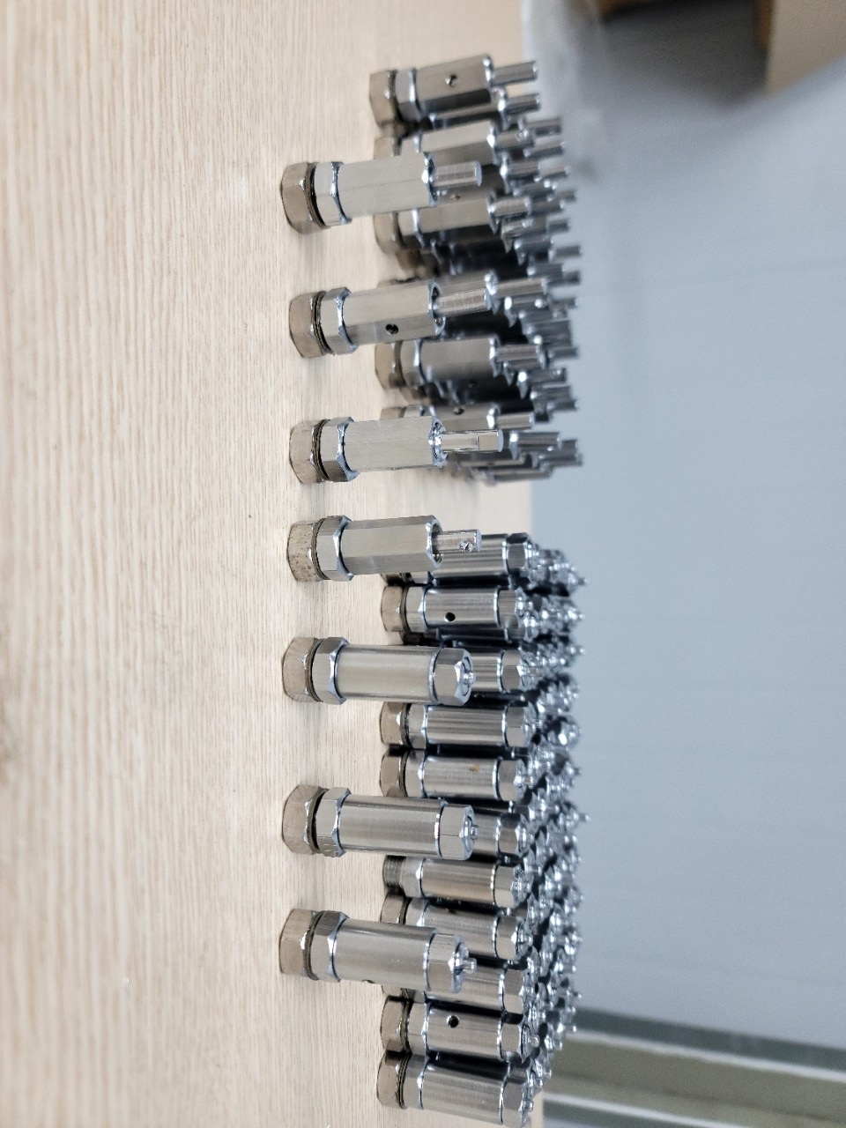
PROFFILE
NAGE VIETNAM TECHNOLOGY.,JSC
COMPANY PROFILE

Slide 2
INDEX
OPEN LETTER
COMPANY MESSAGE
BUSINESS STRATEGY
COMPANY INFORMATION
ORGANIZATION CHART
INFRASTRUCTURE
HUMAN RESOURCE CAPACITY
PRODUCTION CAPACITY
PRODUCTS
PARTNERS

Slide 3
1. OPEN LETTER
NAGE Vietnam Technology Joint Stock Company was established on December 9, 2021. With the desire to bring to customers and partners the best products in the stamping, welding... household appliances industry at the best price. Most suitable so that every time our partners and customers come to our kitchen space, we will have the most comfortable and happiest feeling when serving our families warm, loving, connected meals.
Coming to NAGE Vietnam Technology Joint Stock Company, we are valued customers and partners to the NAGE brand. And come to products manufactured and managed according to Japan's most advanced processes. Along with a team of highly qualified and experienced personnel in the mechanical industry in general and stamping in particular.
Currently, with the trust of customers, the NAGE brand has been cooperating with a number of domestic and foreign businesses such as TIGER company of Japan, Thu Do electronic scales Co., Ltd., Co., Ltd. Thinh Phat dental equipment...etc. Orientation to build and become a leading brand in the stamping industry and household goods with the motto "Quality creates brand value" - All leaders and employees of the Joint Stock Company NAGE Technology Vietnam is still, and has been, constantly making efforts to complete immediate goals in terms of market, human resources, and commodity capacity to best meet the needs of the domestic market.
NAGE Vietnam Technology Joint Stock Company today is the result of the creativity, persistent strength and determination of a united group that has worked hard to cultivate, believing that in the future, with the consensus Determination and wise leadership - NAGE Vietnam Technology Joint Stock Company will grow strongly.
CÔNG TY CP CN NAGE VIỆT NAM

Slide 4
2. COMPANY MESSAGE
MISSION
Providing customers with the highest quality, most suitable mechanical products - Increasing the value of products for customers - Continuously improving the value of workers' lives
VISION
Building and affirming its position as a leading company in Vietnam in the field of precision mechanical manufacturing - Strongly participating in the global supply chain of mechanical products.
CORE VALUES
Bring the best value to customers - Always share and understand customers - Always be on time with customers - Create lasting trust with customers

Slide 5
3. BUSINESS STRATEGY.
NAGE Vietnam Technology Joint Stock Company's business strategy for sustainable development is a core factor in creating value not only through economic development but also associated with activities in the field of environment and health. society.
We always put sustainable development at the core of our business strategy.
With three pillars of development: Economy - Environment - Society, the Company has set business goals, protecting reputation and maintaining sustainable success.
Gradually building the Company into a leading unit in the production and trading of household goods and kitchen equipment, strong in organization and stronger in brand

Slide 6
4. COMPANY INFORMATION
Tên tiếng việt:
Tên tiếng anh:
Tên viết tắt:
Mã số thuế:
Người đại diện:
Trụ sở chính:
VPGD/ Nhà máy:
Số điện thoại:
Email
Website:
CÔNG TY CỔ PHẦN CÔNG NGHỆ NAGE VIỆT NAM
NAGE VIET NAM TECHNOLOGY .,JSC
NAGE VIET NAM.,JSC
0109850492
ÔNG LÊ NHƯ TRANG – Chức vụ: Giám Đốc
Thôn Thượng Thụy, Đức Thượng, Hoài Đức, TP Hà Nội
Số 67 Đường Bờ Sông, Bích Hòa, Thanh Oai, TP Hà Nội
0984889933
infor@nage.vn
Nage.vn
Vietnamese name:
English name:
Abbreviations:
Tax code:
Representative:
Head office:
Office/Factory:
Phone number:
Email:
Website:
CÔNG TY CỔ PHẦN CÔNG NGHỆ NAGE VIỆT NAM
NAGE VIET NAM TECHNOLOGY .,JSC
NAGE VIETNAM.,JSC
0109850492
MR. LE NHU TRANG – Position: Director
Thuong Thuy Village, Duc Thuong, Hoai Duc, Hanoi City
No. 67 Riverside Road, Bich Hoa, Thanh Oai, Hanoi City
0984889933
info@nage.vn
Nage.vn

Slide 7
5. ORGANIZATIONAL CHART
BOARD OF MANAGEMENT
BOARD OF DIRECTORS
DEPUTY DIRECTOR OF SALES
DEPUTY TECHNICAL DIRECTOR
HUMAN RESOUCES DEPARTMENT
ACCOUNTING DEPARTMENT
QC DEPARTMENT
PRODUCTION WORKSHOP
WAREHOUSING
PURCHASE DEPARTMENT

Slide 8
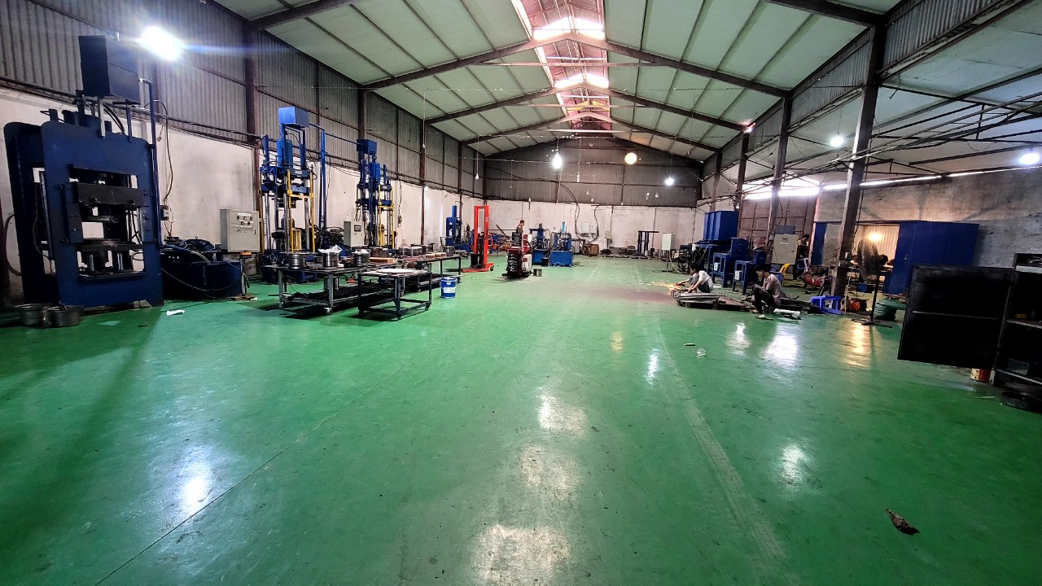
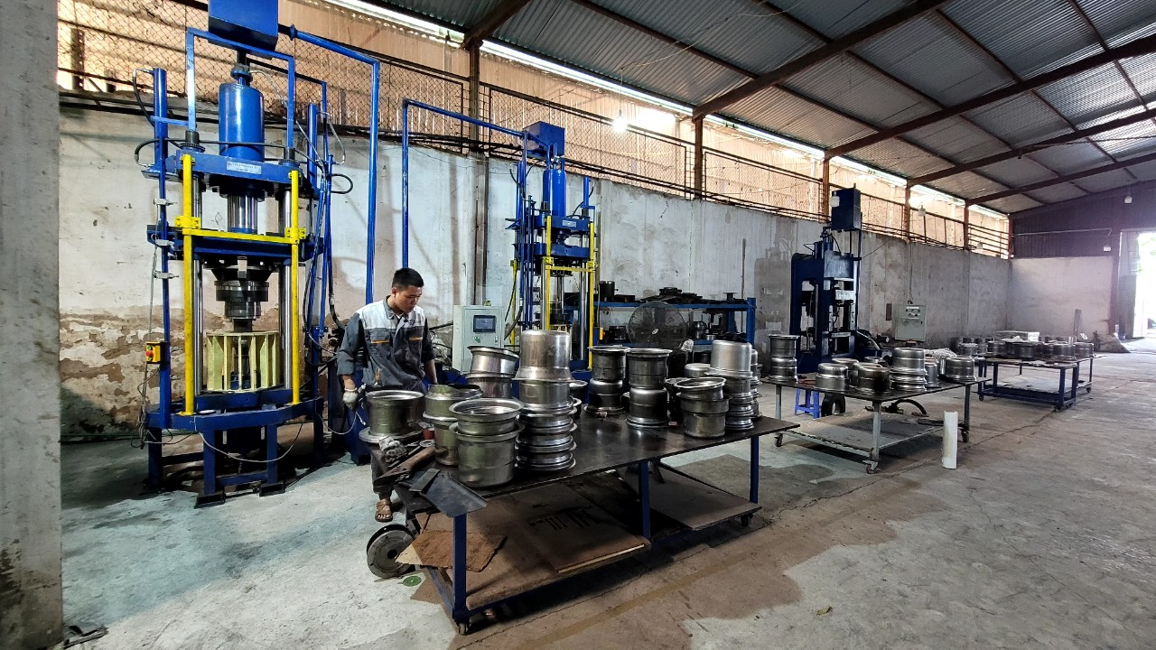
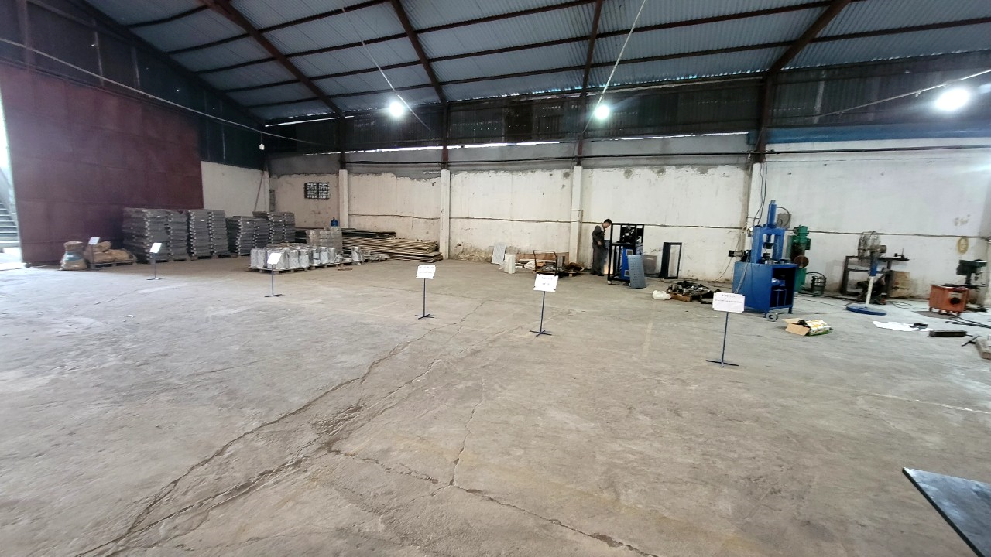
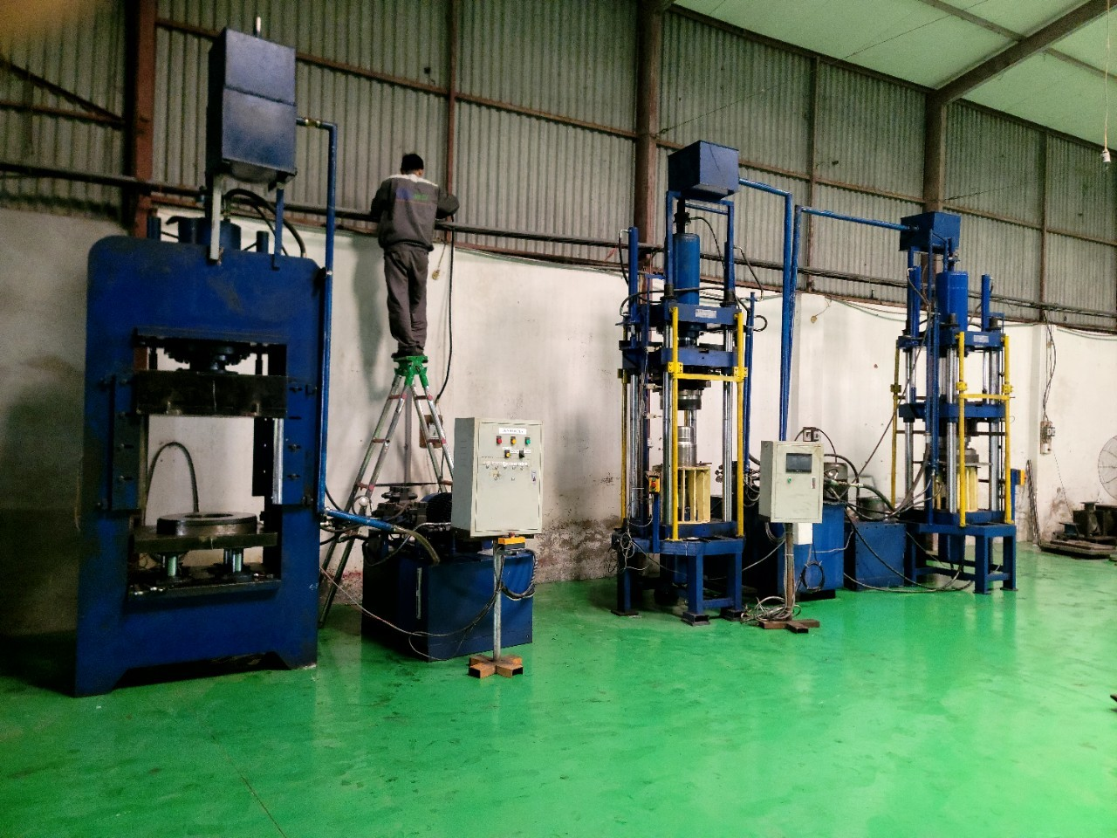
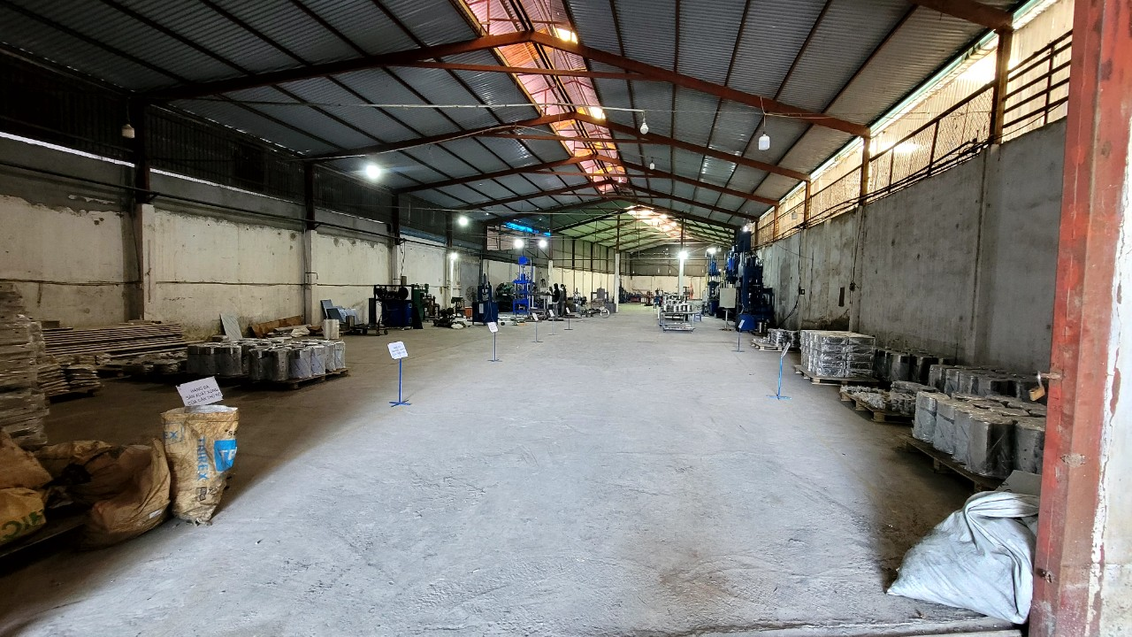
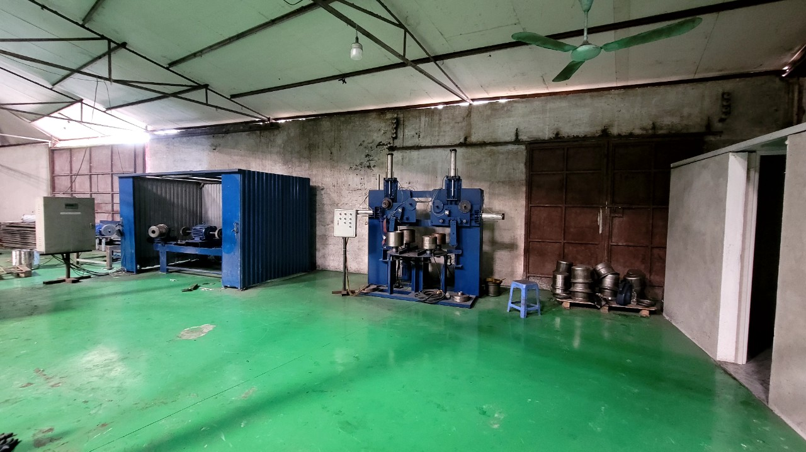
6. INFRASTRUCTURE

Slide 9
7. HUMAN RESOURCE CAPACITY
BOARD OF DIRECTORS
MR: NGUYEN VAN TUYEN - Engineer. CONSTRUCTION MACHINERY POSITION: CTHĐ
MR: LE NHU TRANG - PhD. MECHANICAL ENGINEERING OFFICER: DIRECTOR
MR: LE CAO BANG – Engineer. MACHINECAL POSITION: DEPUTY DIRECTOR
ACCOUNTING DEPARTMENT
02 HUMAN RESOURCES
GENERAL ADMINISTRATIVE OFFICE
02 HUMAN RESOURCES
PRODUCTION WORKSHOP
03 ENGINEERS
02 TECHNICIANS
02 QC STAFF
20 WORKERS
ADVISORY BOARD
Lecturer K. Mechanical Engineering - University of industrial economics and technology
Lecturer K. CNCTM. Pressure GC - School of Mechanical Engineering - Hanoi University of Science and Technology

Slide 10
8. PRODUCTION CAPABILITY
SIDE-DYNAMIC HYDRAULIC PRESS
01 PRESSING MACHINE 300 TONS
02 200 TONS PRESSING MACHINE
01 PRESSING MACHINE 80 TONSHYDRAULIC PRESS MACHINE
01 80 TON PRESSING MACHINE
02 15 TONS PRESSING MACHINEPOLISHING MACHINE
02 MULTI-FUNCTIONAL POLISHING MACHINE HL
01 AB POLISHING MACHINEOTHER MACHINES
01 AUTOMATIC EDGEING MACHINE
01 AUTOMATIC TUBE PRESSING MACHINE FOR TUBING HEADS
01 SEMI-AUTO TUBE DRINKING MACHINE
02 PIPE BENDING MACHINES ACCORDING TO PRODUCTS
02 LASER WELDING MACHINE 1500KW
02 COLD TIG WELDING MACHINES 250A

Slide 11
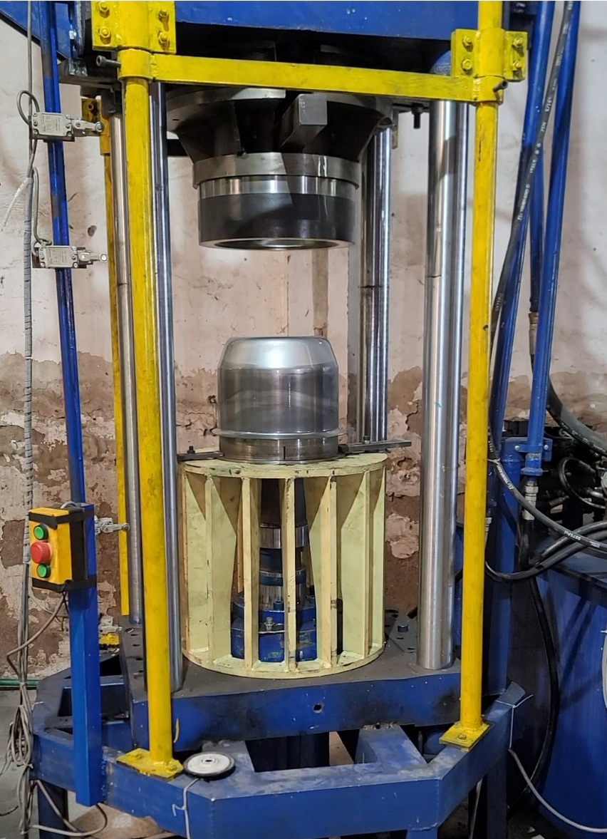
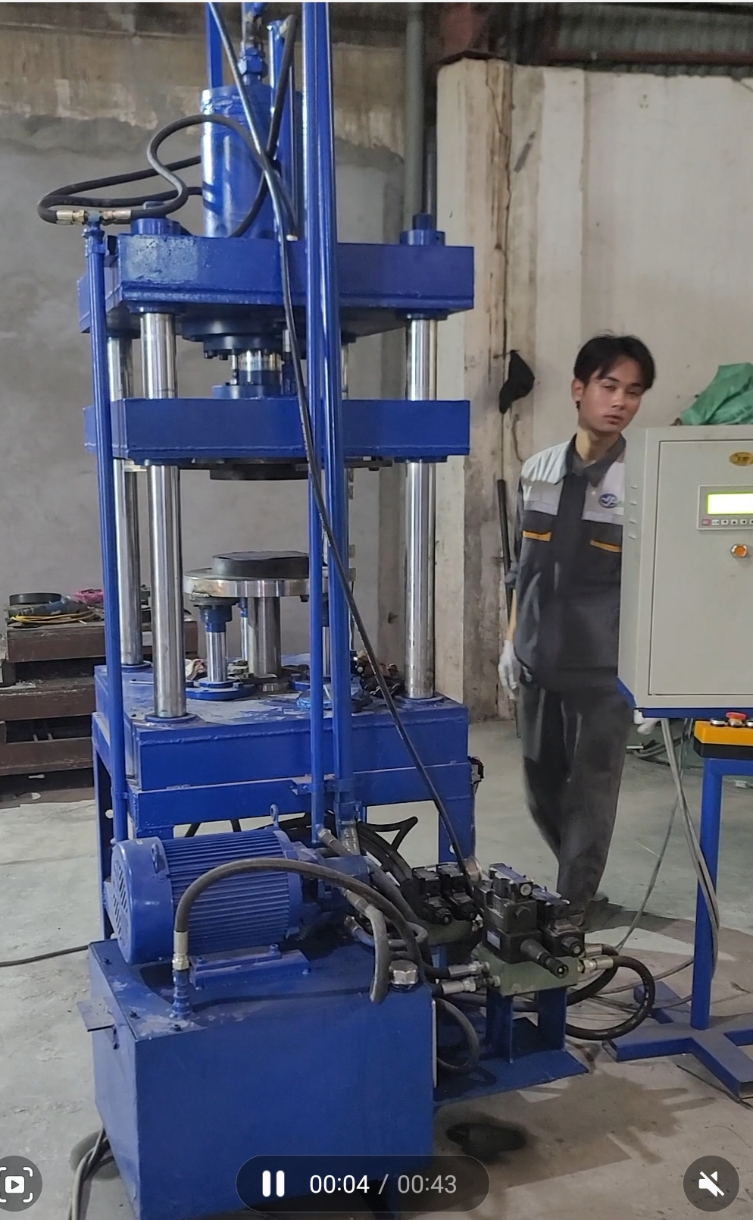
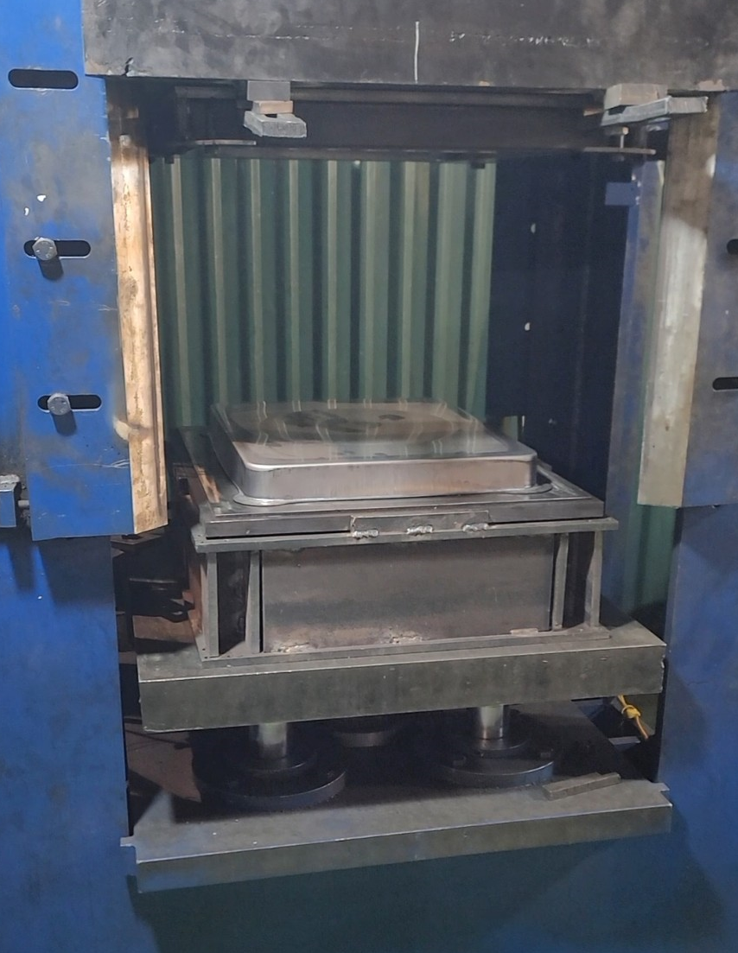
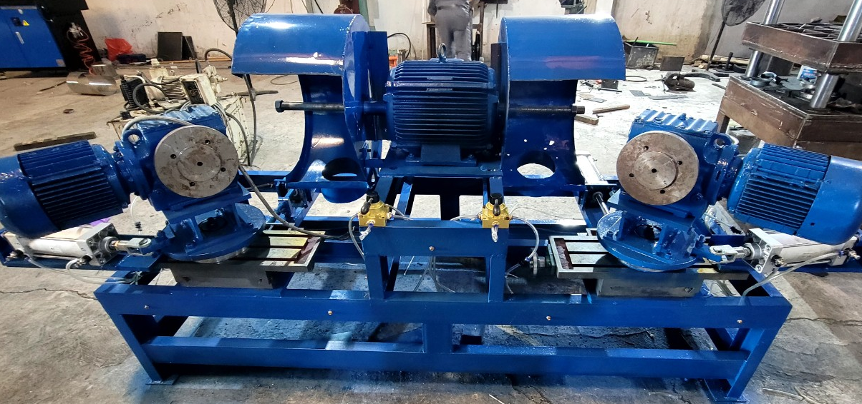
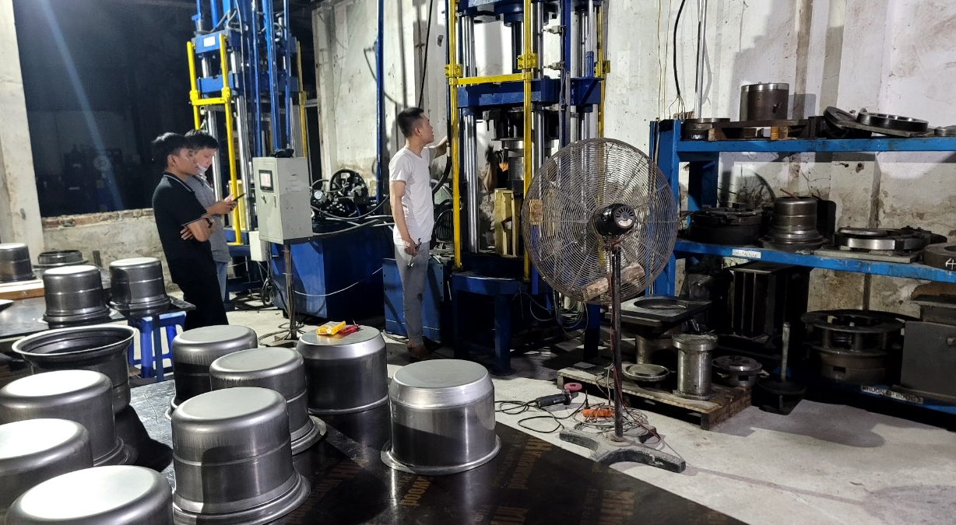
8. PRODUCTION CAPABILITY

Slide 12
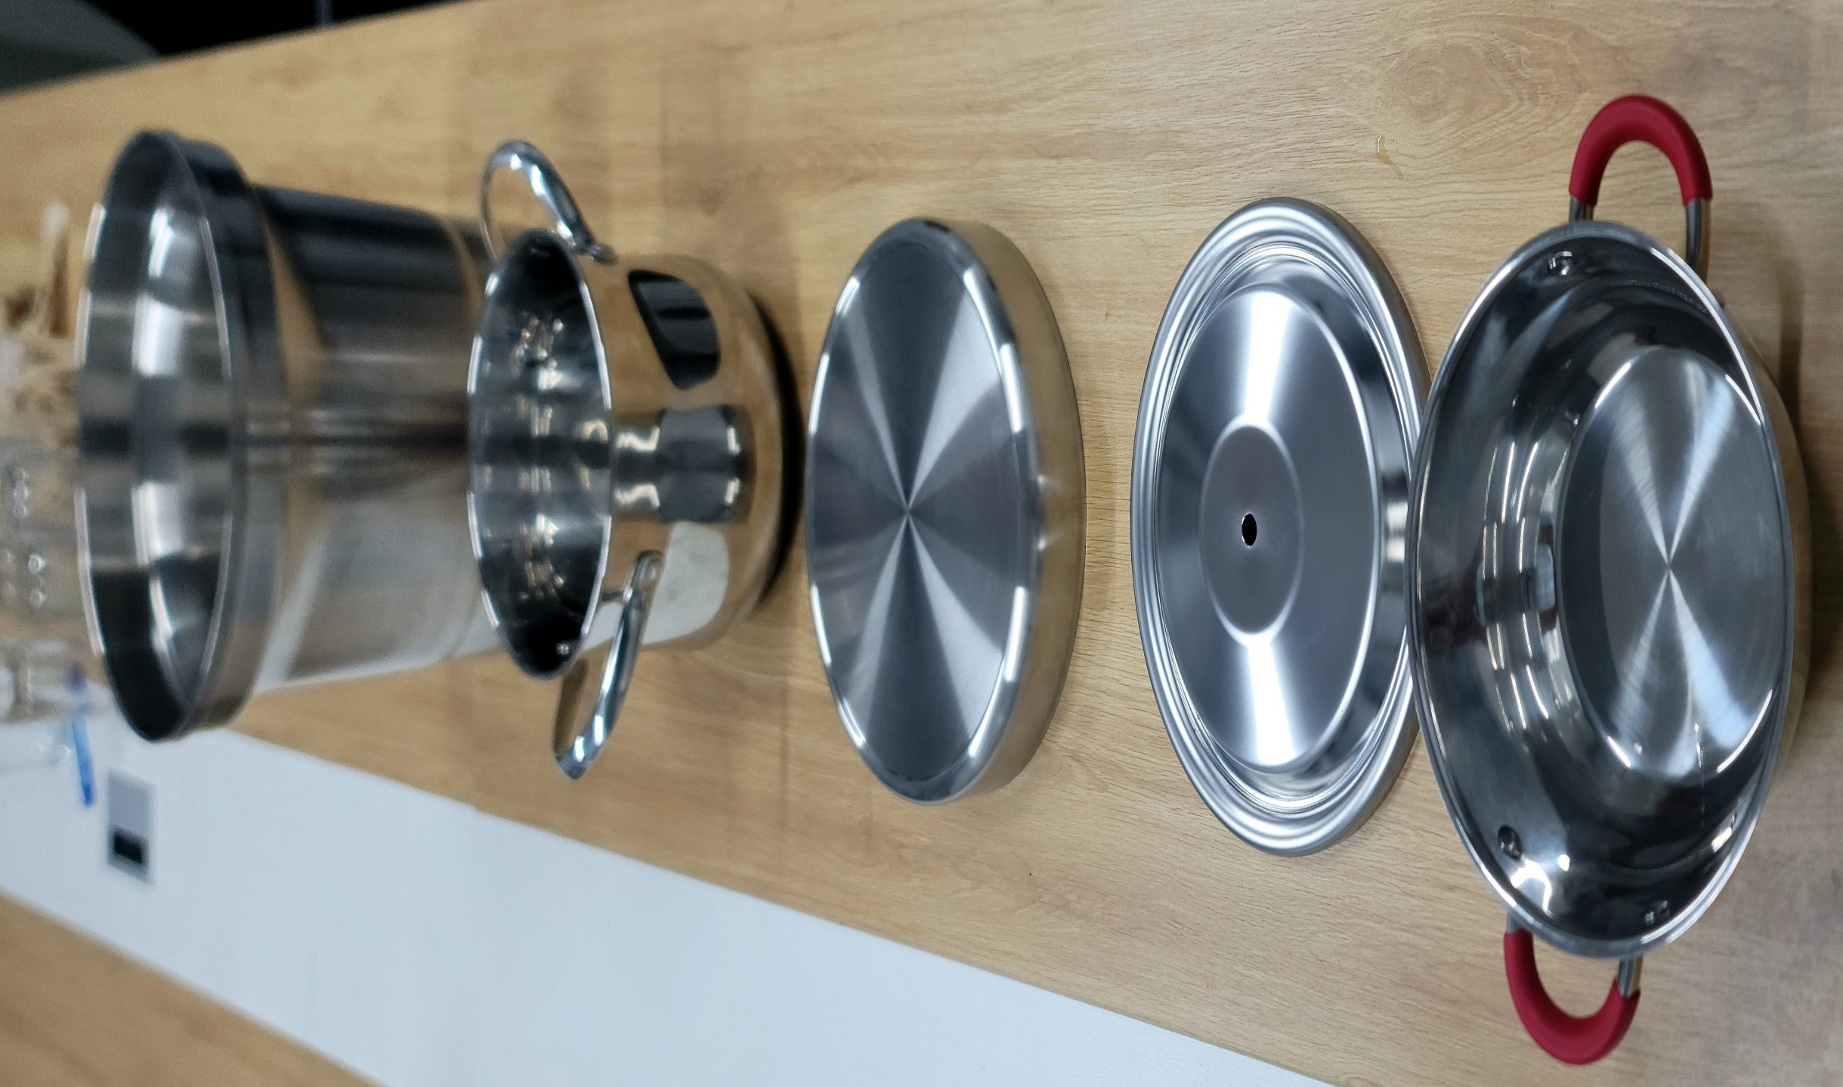
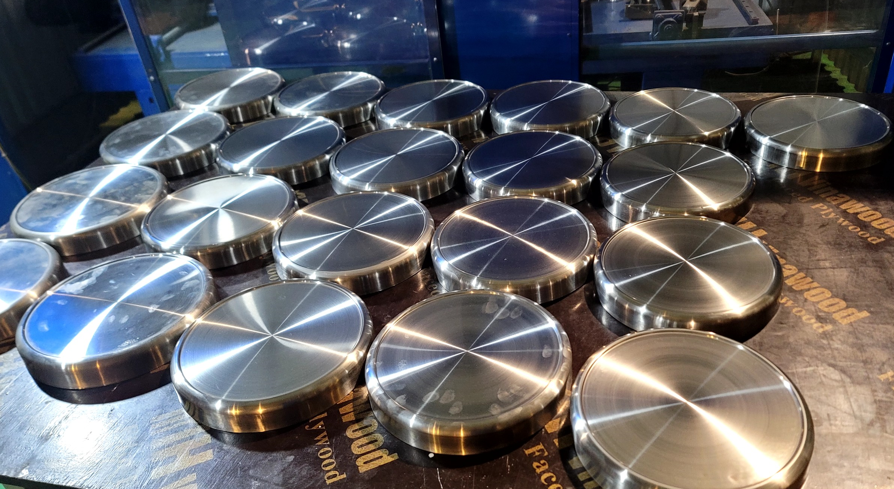
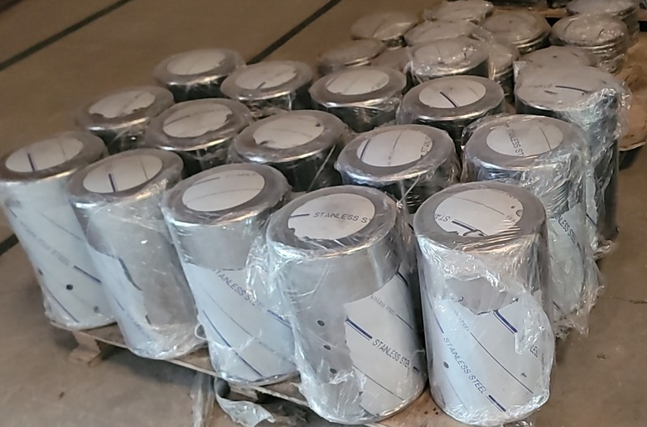
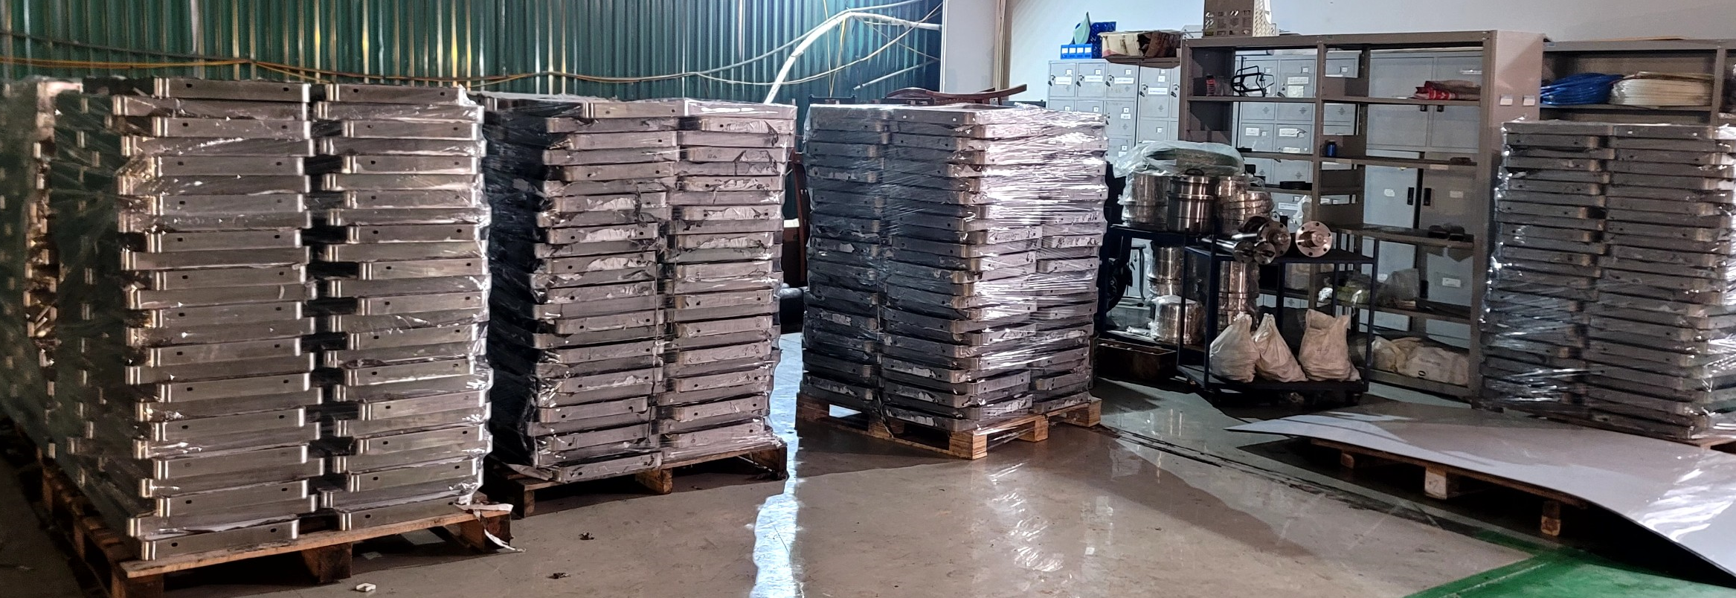
9. PRODUCTS

Slide 13
9. PRODUCTS
13

Slide 14
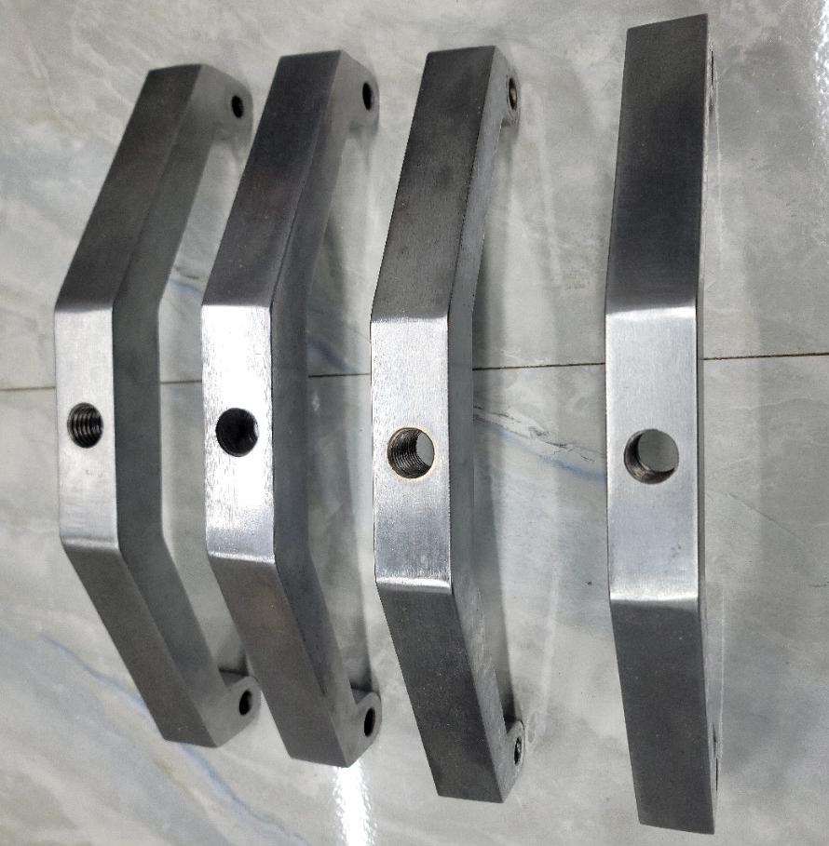
9. PRODUCTS

Slide 15

10. STRATEGIC PARTNER OF NAGE
15

Slide 16

CÔNG TY CỔ PHẦN CÔNG NGHỆ NAGE VIỆT NAM
Trụ sở chính: Thôn Thượng Thụy, xã Đức Thượng, huyện Hoài Đức, thành phố Hà Nội
Số điện thoại: 0984889933
Xưỡng sản xuất: Số 67 Đường Bờ Sông, xóm Mùi, xã Bích Hòa, huyện Thanh Oai, tp Hà Nội
Email: infor@nage.vn
Website: nage.vn
NAGE VIETNAM TECHNOLOGY., JSC
Head office: Thuong Thuy hamlet, Duc Thuong commune, Hoai Duc district, Hanoi city
Factory: No. 67 Bo Song Street, Mui hamlet, Bich Hoa commune, Thanh Oai district, Hanoi city
Phone number: 0984889933
Email: info@nage.vn
Website: nage.vn
16

